Slide 1

TRAINING ANALYTICS PORTAL
Go, change the world®
Department of Master of Computer Applications
Minor Project (MCA461P) – Phase 1
A Web-Based Dashboard for Trainee Performance Tracking and Analytics
Under the Guidance
of
Dr. Andhe Dharani
Professor
Department of Master of Computer Applications
Akash Bhagoji 1RV25MC006
Anmol Jain 1RV25MC015

Slide 2






Agenda
Click any section to jump straight to it.
1
2
3
Introduction and Problem
Literature Survey
Objectives and Workflow
Why the portal is needed
Ten papers and what they offer our project
Project scope, goals and the user journey
Slides 3–4 →
Slides 5–6 →
Slides 7–8 →
4
5
6
Roles, Progress and Demo
Architecture and Methodology
Outcomes, Quick Check, References
Who uses it, build status, dashboard mockups
Frontend, backend, database and the plan
Requirements, future scope, quiz, sources
Slides 9–12 →
Slides 13–17 →
Slides 18–25 →

Slide 3

Introduction
The Training Analytics Portal is a web-based application intended to centralize trainee performance records and present insights through dashboards and charts.
It aims to help trainers review trainee progress using session-wise scores, error counts and time taken.
“Transforming training records into actionable performance insights.”
Training Records
Centralized Data
Analytics Dashboard
Performance Insights
Proposed system under development; the workflow shown is the intended design.

Slide 4
Problem Statement
The project aims to address these challenges:
Manual Records
Difficult Comparison
Delayed Insights
Performance records scattered across files or spreadsheets.
1
Proposed centralized dashboard (concept)
Time-consuming comparisons between training sessions.
2
Avg score
Errors
Time
Difficulty identifying repeated errors or declining performance.
3
Limited visibility into individual and batch-level progress.
4
Conceptual illustration

Slide 5
Literature Survey – Part 1
Paper | Research Focus | Relevance to Our Project
[1] S. D. A. Bujang et al. (2021), “Multiclass Prediction Model for Student Grade Prediction Using Machine Learning,” IEEE Access. | Multiclass student grade prediction using machine learning. | Shows how student performance can be grouped into grade classes; informs how trainee performance levels may be categorized.
[2] M. Khan et al. (2023), “Utilizing Machine Learning Models to Predict Student Performance From LMS Activity Logs,” IEEE Access. | Performance prediction from learning-management activity data. | Supports using recorded activity data as the basis for performance analysis, similar to our session records.
[3] E. Alhazmi and A. Sheneamer (2023), “Early Predicting of Students Performance in Higher Education,” IEEE Access. | Early prediction of student performance in higher education. | Highlights early identification of learners who need support, aligned with trainer review of progress.
[4] R. Alamri and B. Alharbi (2021), “Explainable Student Performance Prediction Models: A Systematic Review,” IEEE Access. | Systematic review of explainable performance prediction models. | Motivates clear, understandable indicators such as scores, errors and time in our dashboards.
[5] J. Jovanović et al. (2021), “Students Matter the Most in Learning Analytics: The Effects of Internal and Instructional Conditions in Predicting Academic Success,” Computers & Education. | Role of learner and instructional conditions in predicting academic success. | Reminds us that training context affects how performance data should be interpreted.

Slide 6
Literature Survey – Part 2
Paper | Research Focus | Relevance to Our Project
[6] S. Limanto, J. L. Buliali and A. Saikhu (2022), “A Two-Stage Early Prediction Model to Monitor the Students’ Academic Progress,” Proc. ICoICT. | Two-stage early prediction: a baseline at course start, updated at week 8. | Supports checking a baseline first and then tracking progress over time, like session-wise tracking.
[7] J. Chowdhery et al. (2021), “Automatic Student Performance Prediction System Using Data Mining Techniques,” Proc. I3CAT. | Student performance prediction using data mining techniques. | Illustrates use of recorded student data for performance analysis.
[8] P. I. Pavlik Jr., L. G. Eglington and L. M. Harrell-Williams (2021), “Logistic Knowledge Tracing: A Constrained Framework for Learner Modeling,” IEEE Trans. Learn. Technol. | Learner modeling framework for tracing knowledge. | Relates to following learner performance over repeated attempts, like our sessions.
[9] B. Albreiki, N. Zaki and H. Alashwal (2021), “A Systematic Literature Review of Student Performance Prediction Using Machine Learning Techniques,” Educ. Sci. | Systematic review of machine learning for performance prediction. | Gives an overview of approaches in the field, helping position our project scope.
[10] Z. Chen et al. (2023), “Student Performance Prediction Approach Based on Educational Data Mining,” IEEE Access. | Prediction approach using educational data mining. | Reinforces that educational data can support performance analysis.
Literature synthesis
Educational data can support performance analysis.
Tracking progress over time can complement static assessment.
Understandable indicators can help explain trends.
Predictive models must be evaluated in their original context.

Slide 7


Research Gap and Project Objectives
Intended project scope: a centralized interface for reviewing session-wise scores, errors, time taken and performance trends. This describes the scope of our project, not a claim that no existing solution offers these features.
1
2
3
4
5
Centralize trainee performance records.
Record session-wise scores, errors and completion time.
Visualize individual and batch-level performance trends.
Provide role-based access for trainers and trainees.
Support informed training decisions.
See slide 9 →
See slide 8 →
See slide 11 →
See slide 9 →
See slide 18 →

Slide 8



Interactive User Storyboard and Workflow
Proposed workflow
Click a stage to open the related slide.
1
2
3
4
5
6
LOGIN
SELECT
RECORD
STORE
ANALYZE
ACT
Trainer or trainee enters the portal.
Trainer selects a batch or trainee.
Session scores, errors and completion time are entered.
Data is sent to the backend and stored in the database.
Dashboard charts show performance trends.
Trainer reviews trends and identifies trainees who may need support.
Slide 9 →
Slide 9 →
Slide 10 →
Slide 13 →
Slide 11 →
Slide 11 →

Slide 9


Proposed System and User Roles
Admin / Trainer
Trainee
Manage batches and trainee records.
Record and update session results.
View batch-level analytics.
Review score and error trends.
View personal dashboard.
Review session history.
Track score progression.
Review error and time trends.
Proposed mockup
Proposed mockup
Open Trainer Dashboard →
Open Trainee Dashboard →

Slide 10
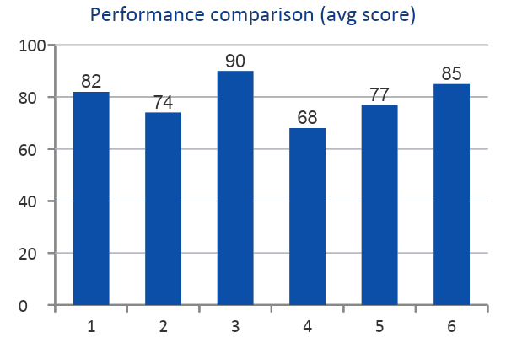
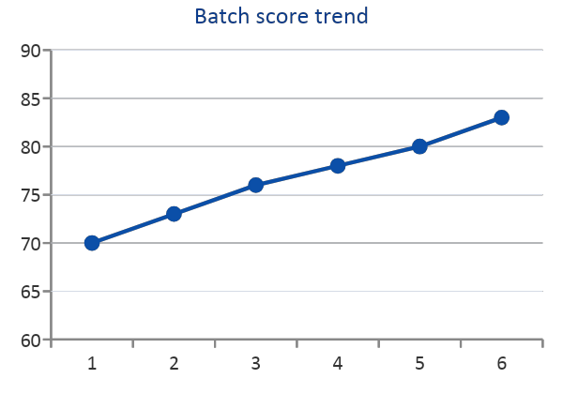
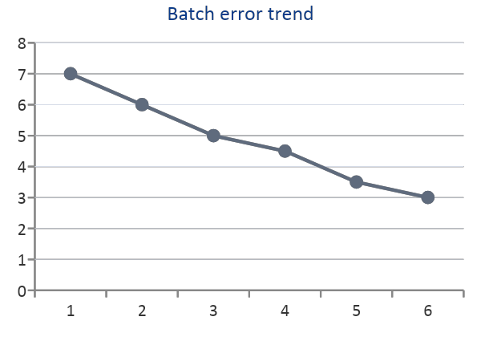
Dashboard Demo – Trainer View
Trainer Dashboard
Trainee Dashboard
Proposed UI Mockup – Illustrative Data, Not Actual Project Results
Batch average score
78 / 100
Average errors per session
4.2
Average time taken
18 min

Slide 11
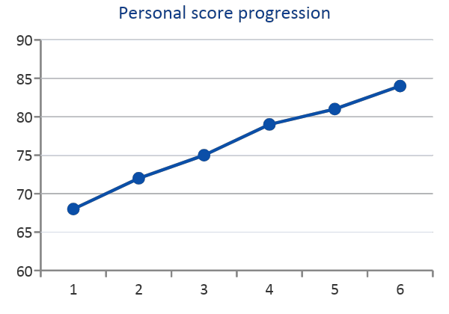
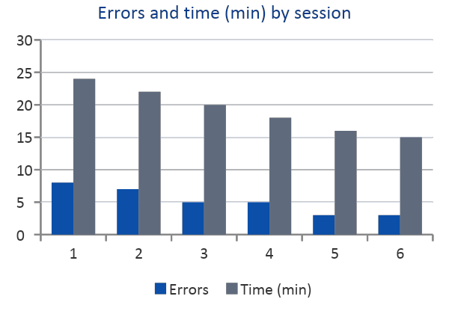
Dashboard Demo – Trainee View
Trainer Dashboard
Trainee Dashboard
Proposed UI Mockup – Illustrative Data, Not Actual Project Results
Latest session score
84 / 100
Sessions completed
6
Average time taken
19 min
Session history
Session | Score | Errors | Time
S1 | 68 | 8 | 24
S2 | 72 | 7 | 22
S3 | 75 | 5 | 20
S4 | 79 | 5 | 18
S5 | 81 | 3 | 16
S6 | 84 | 3 | 15

Slide 12

System Architecture
Proposed architecture
Click a layer to see its responsibilities.
FRONTEND
BACKEND
DATABASE
HTTP / REST
Queries
React
Tailwind CSS
Recharts / Chart.js
Axios (HTTP client)
Node.js + Express.js
Planned: validation
Planned: application logic
Planned: authentication and authorization
MongoDB + Mongoose
Entities: User, Batch, Trainee, Session, Result
JSON response
Results
Request flow: Frontend → Backend API → Database Response flow: Database → Backend API → Frontend

Slide 13
Frontend Layer
Proposed design
Responsibilities (planned)
Technologies
Present trainer and trainee dashboards.
Render score, error and time charts.
Provide forms to enter session results.
Call the backend through REST requests.
Show views according to the user role.
React
Tailwind CSS
Recharts / Chart.js
Axios (HTTP client)

Slide 14
Backend Layer
Proposed design
Responsibilities (planned)
Technologies
Expose REST API endpoints to the frontend.
Validate incoming data before it is stored.
Apply application logic for sessions and results.
Authenticate users and authorize roles.
Read from and write to the database.
Node.js
Express.js
Authentication and authorization (planned)
Request validation (planned)

Slide 15
Database Layer
Proposed design
Responsibilities (planned)
Proposed entities
Store users, batches and trainees.
Store sessions and their results.
Keep scores, errors and time taken per session.
Support queries for individual and batch trends.
User
Batch
Trainee
Session
Result

Slide 16
Proposed Development Methodology
1
2
3
4
5
Requirements analysis
UI, database and architecture design
Frontend and backend development
API integration and analytics
Testing, refinement, documentation and deployment
Gather trainer and trainee needs; define the score, error and time data.
Plan screens, MongoDB entities and the three-layer architecture.
Build React screens and Express.js APIs.
Connect the UI to the APIs and add dashboard charts.
Test, refine, document and deploy.
See slide 18 →
See slide 13 →
See slide 10 →
See slide 11 →
See slide 18 →

Slide 17

Requirements, Outcomes and Future Scope
Software requirements
Hardware requirements
React and Tailwind CSS
Recharts or Chart.js
Node.js and Express.js
MongoDB and Mongoose
VS Code, Git, browser, API testing tools
Development computer
Adequate RAM and storage
Internet connectivity for development and hosted services
Expected outcomes
Future scope
Centralized performance records
Easier session-wise comparisons
Better visibility into trainee and batch trends
Email summaries
Missed-session notifications
PDF / CSV report export
Optional performance risk flags
Learning management system integration

Slide 18
References and Questions
[1] S. D. A. Bujang, A. Selamat, R. Ibrahim, and O. Krejcar, “Multiclass prediction model for student grade prediction using machine learning,” IEEE Access, vol. 9, pp. 95608–95621, 2021, doi: 10.1109/ACCESS.2021.3093563
[2] M. Khan, S. Naz, Y. Khan, M. Zafar, M. Khan, and G. Pau, “Utilizing machine learning models to predict student performance from LMS activity logs,” IEEE Access, vol. 11, pp. 86953–86962, 2023, doi: 10.1109/ACCESS.2023.3305276
[3] E. Alhazmi and A. Sheneamer, “Early predicting of students performance in higher education,” IEEE Access, vol. 11, pp. 27579–27589, 2023, doi: 10.1109/ACCESS.2023.3250702
[4] R. Alamri and B. Alharbi, “Explainable student performance prediction models: A systematic review,” IEEE Access, vol. 9, pp. 33132–33143, 2021, doi: 10.1109/ACCESS.2021.3061368
[5] J. Jovanović, M. Saqr, S. Joksimović, and D. Gašević, “Students matter the most in learning analytics: The effects of internal and instructional conditions in predicting academic success,” Comput. Educ., vol. 172, Art. 104251, 2021, doi: 10.1016/j.compedu.2021.104251
[6] S. Limanto, J. L. Buliali, and A. Saikhu, “A two-stage early prediction model to monitor the students’ academic progress,” in Proc. 10th Int. Conf. Inf. Commun. Technol. (ICoICT), 2022, pp. 195–200, doi: 10.1109/ICoICT55009.2022.9914882
[7] J. Chowdhery, A. Jasmin, A. Jaiswal, and J. A. A. Jothi, “Automatic student performance prediction system using data mining techniques,” in Proc. Int. Conf. Comput. Commun. Appl. Technol. (I3CAT), 2021, pp. 1–6, doi: 10.1109/I3CAT53310.2021.9629427
[8] P. I. Pavlik Jr., L. G. Eglington, and L. M. Harrell-Williams, “Logistic knowledge tracing: A constrained framework for learner modeling,” IEEE Trans. Learn. Technol., vol. 14, no. 5, pp. 624–639, 2021, doi: 10.1109/TLT.2021.3128569
[9] B. Albreiki, N. Zaki, and H. Alashwal, “A systematic literature review of student’ performance prediction using machine learning techniques,” Educ. Sci., vol. 11, no. 9, Art. 552, 2021, doi: 10.3390/educsci11090552
[10] Z. Chen, G. Cen, Y. Wei, and Z. Li, “Student performance prediction approach based on educational data mining,” IEEE Access, vol. 11, pp. 131260–131272, 2023, doi: 10.1109/ACCESS.2023.3335985
Click any DOI to open the paper's record.
Thank You
Notes:
Bibliographic details (authors, venues, volumes, pages, DOIs) follow the supplied verified reference list. Paper 6 was independently cross-checked (title, authors, ICoICT 2022, DOI). Paper 7 (Chowdhery et al., I3CAT 2021) could not be independently confirmed; check its DOI on IEEE Xplore before the final submission.

